Slide 1
Intro to React, Components, and JSX
Lesson 19.1

Slide 2
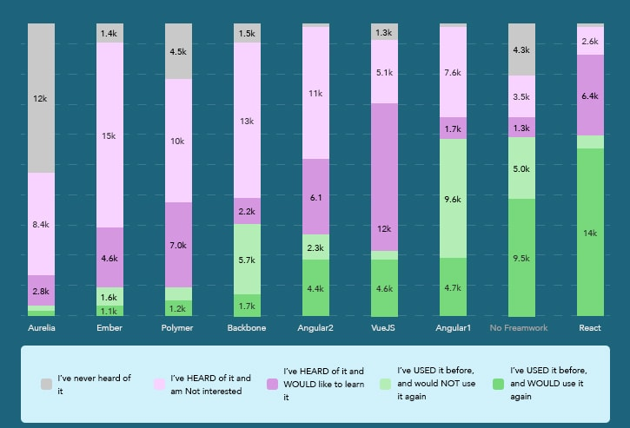
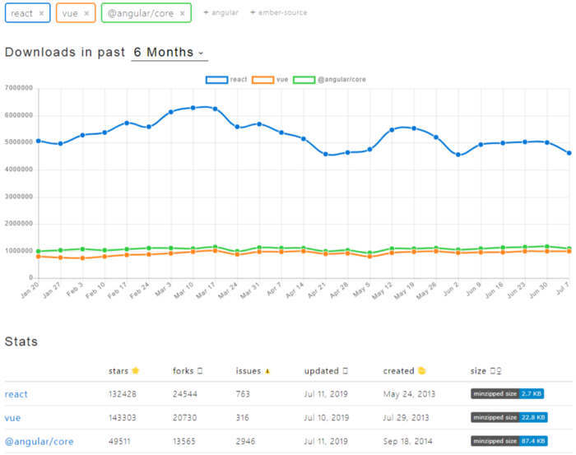



React is one of the most powerful, in-demand front-end JavaScript libraries available today.
Notes:
Second is npm downloads
At Tableau we switched from Angular to React

Slide 3
Just about every popular UI library that came after React borrows from it.
Libraries are like fads that come and go, but the ideas introduced by React appear to be here to stay.
Notes:
Vue borrows a lot of the concepts – specifically virtual DOM

Slide 4

React
React is:
An open-source JavaScript library developed by Facebook for developing UIs
Developed to build large apps with rapidly changing data
Component-based: UI elements are broken into self-contained components

Slide 5
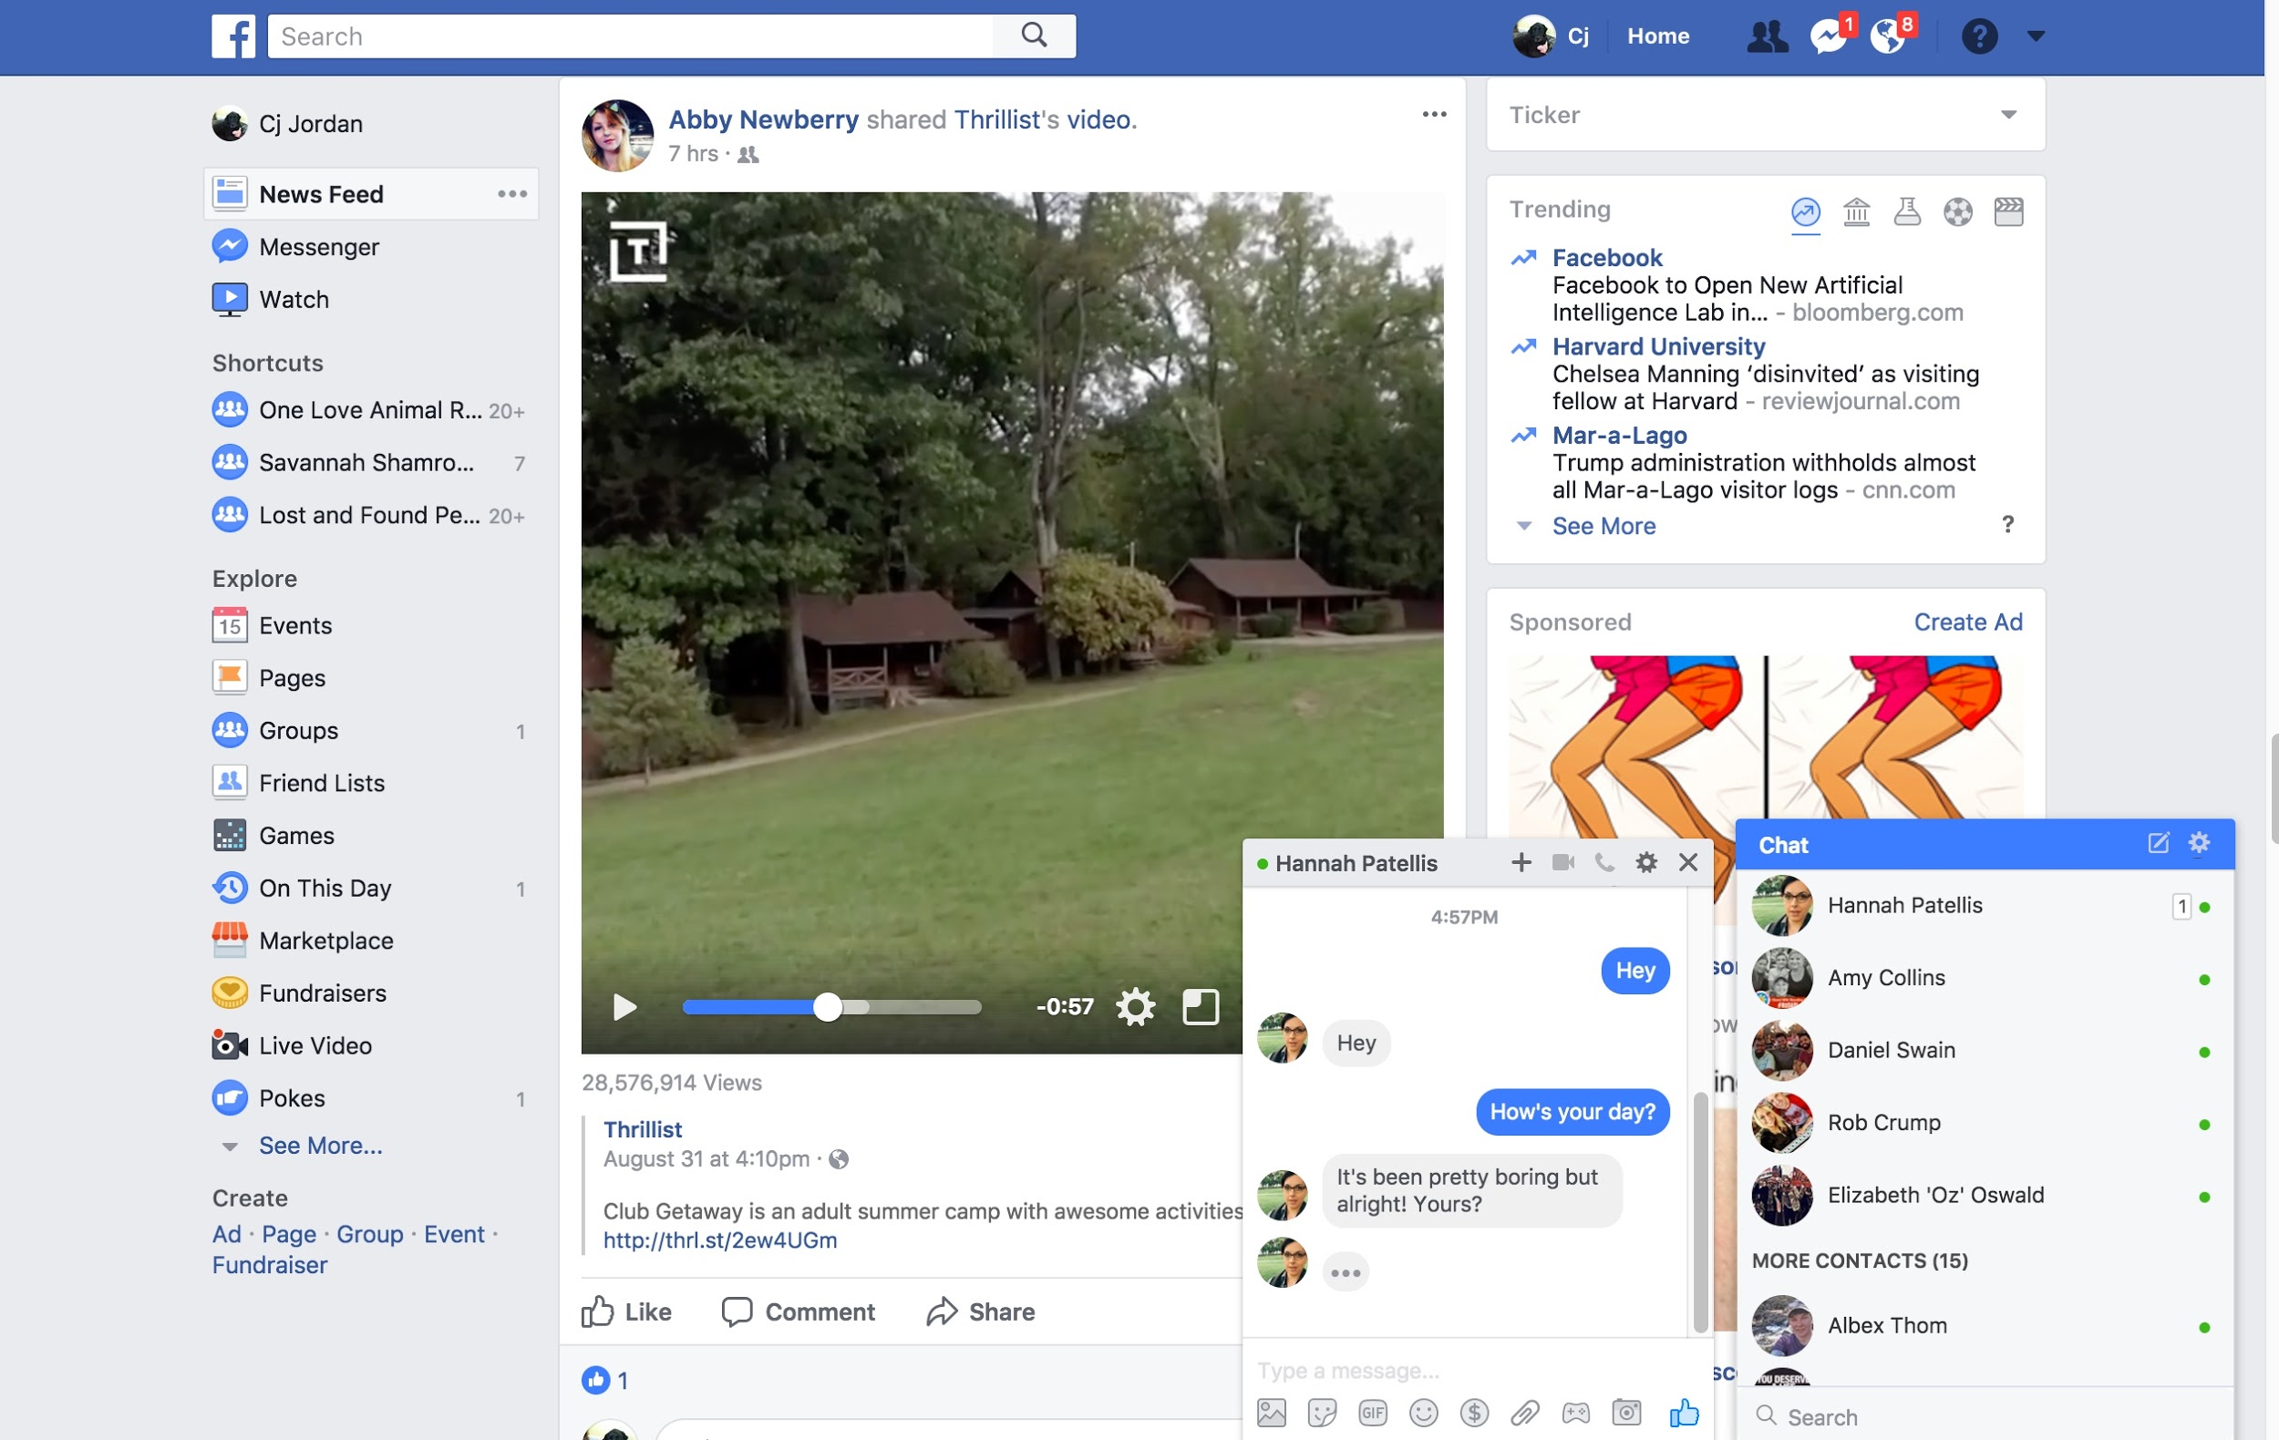
Facebook's UI Complexities
Facebook buzzes with interactive options, live-updating data, and tightly interacting elements. This poses a challenge to simple DOM.

Slide 6
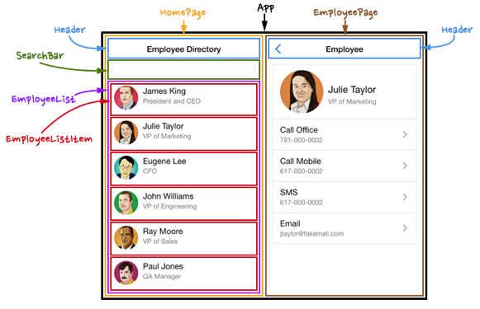
The Concept of Components
Using React, UI elements are broken down into reusable components.
Each sub-component behaves in a way that it is fully contained.

Slide 7
The Power of Components
Why separate UI elements into components?
Logically decompose a UI into unique parts
Easily reuse these parts without re-coding
Easier to test
Helps you find bugs and saves time

Slide 8
Data-Shifting Applications

Slide 9
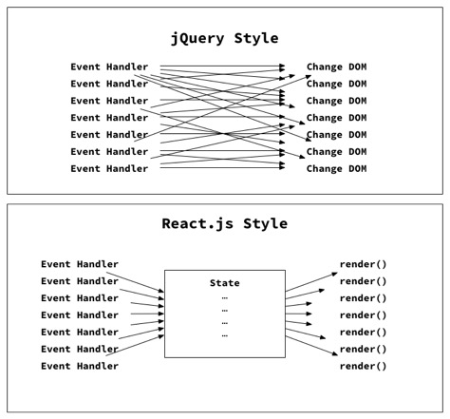
How Is This Different Than jQuery?
In jQuery, the application’s state and UI are updated independently of each other.
With React, whenever the application’s state changes, the DOM updates to reflect it.
With React, the UI is a pure function of the application’s state.
Notes:
React deterministically renders a UI based on state

Slide 10
Rapid Data Changes: Option #1 jQuery
JavaScript is FAST, but whenever we update the DOM, the browser needs to recalculate the CSS, update the layout, and repaint the web page. This can be a slow process.
Data-Driven Events
DOM
Article Comments
Users Signed On
Weather Forecast
Newsfeed Articles
Messages Sent
Notes:
Painting = pixel by pixel determining what to draw
We change something small but have to re-do everything every time
The DOM is often a performance bottleneck, a virtual DOM minimizes the affected tree of DOM to update using a custom diff algorithm

Slide 11
Rapid Data Changes: Option #2 React
React’s Virtual DOM serves as an intermediary and avoids unnecessary trips to the DOM.
Data-Driven Events
DOM
Article Comments
Users Signed On
Weather Forecast
Newsfeed Articles
Messages Sent
Virtual DOM

Slide 12

Virtual DOM
What?
Notes:
shutterstock_91508951

Slide 13
Document Object Model (DOM)
A Virtual DOM is a JavaScript object that models the real DOM.
Real DOM
Diff
Patch
In-memory DOM
DOM

Slide 14
Document Object Model (DOM)
Whenever some part of the application’s state changes, the Virtual DOM receives the UI updates first.
Real DOM
Diff
Patch
In-memory DOM
DOM

Slide 15
Document Object Model (DOM)
Then the Virtual DOM is compared to the real DOM.
Real DOM
Diff
Patch
In-memory DOM
DOM

Slide 16
Document Object Model (DOM)
React then aims to update with the smallest number of changes.
Real DOM
Diff
Patch
In-memory DOM
DOM

Slide 17


React Pros and Cons
Pros
Reusable components
UI updates in response to state change, reducing DOM manipulation code needed.
Can build applications on web, server, and native applications.
Simplifies our focus, we only care about how to render our app given data, not how to transform the DOM
Easier to learn and more popular than other front-end JavaScript libraries and frameworks.
Cons
React is a view library concerned with rendering user interfaces, not a framework. You have to pull in other libraries to accomplish things like HTTP requests.
Can require more configuration than other libraries.
1
1
2
3
2
4
5

Slide 18

React Is Magical!

Slide 19

Tools: webpack
Webpack lets you modularize front-end code the same way you do in Node with CommonJS modules (require, module.exports). Webpack also lets you apply various transformations on your assets via plugins.

Slide 20
Babel Is a JavaScript Compiler
Babel lets you transpile next-generation JavaScript (ES6, ES7, ES8) into ES5 JavaScript that most browsers understand.

Slide 21
Can’t I just use a CDN for all of this?
Notes:
shutterstock_91508951

Slide 22

You could, but it’d be SUPER slow.
Notes:
shutterstock_1207258801.

Slide 23
Activity: Installation + Documentation Research

